Slide 1
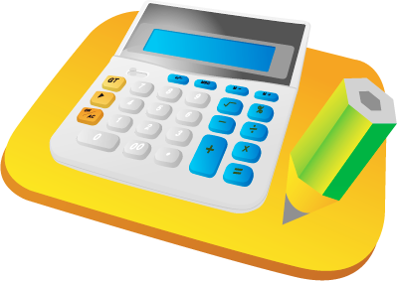
Quiz Time !!!
Chinese Number 1-10

Slide 2
Chinese Number
Yī èr sān sì wǔ
一 二 三 四 五
liù qī bā jiǔ shí
六 七 八 九 十

Slide 3
What number is this? 1-10
8
Text
in here
六
9
6

Slide 4
What number is this? 1-10
5
Text
in here
五
3
2

Slide 5
What number is this? 1-10
3
Text
in here
1
一
4

Slide 6
What number is this? 1-10
3
Text
in here
四
6
4

Slide 7
What number is this? 1-10
4
Text
in here
九
9
5

Slide 8
What number is this? 1-10
8
Text
in here
八
4
7

Slide 9
What number is this? 1-10
2
Text
in here
三
3
1

Slide 10
What number is this? 1-10
6
Text
in here
十
5
10

Slide 11
What number is this? 1-10
7
Text
in here
七
4
6

Slide 12
What number is this? 1-10
3
Text
in here
二
2
8

Slide 13
Pinyin of this Number
Yī
Text
in here
六
wǔ
liù

Slide 14
Pinyin of this Number
sān
Text
in here
五
qī
wǔ

Slide 15
Pinyin of this Number
jiǔ
Text
in here
九
sì
sān

Slide 16
Pinyin of this Number
qī
Text
in here
四
sì
wǔ

Slide 17
Pinyin of this Number
èr
Text
in here
二
sì
bā

Slide 18
Pinyin of this Number
Yī
Text
in here
七
sì
qī

Slide 19
Pinyin of this Number
liù
Text
in here
Yī
一
jiǔ

Slide 20
Pinyin of this Number
sān
Text
in here
十
wǔ
shí

Slide 21
Pinyin of this Number
shí
Text
in here
八
Yī
bā

